Slide 1
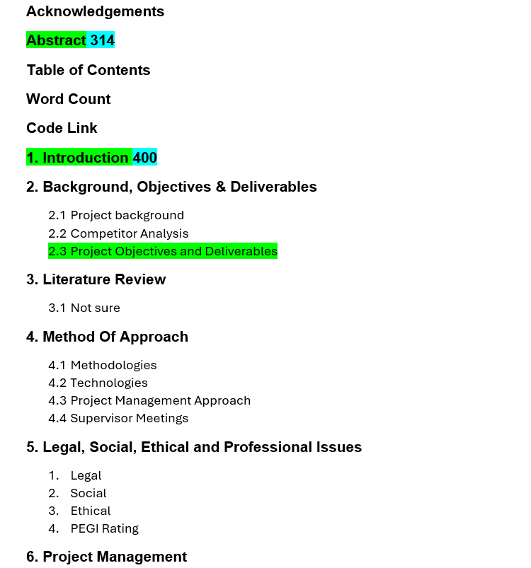
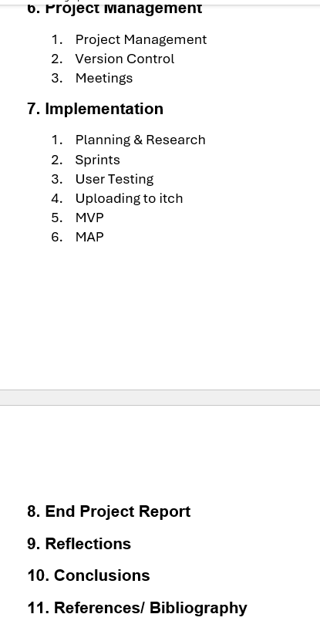

Slide 2
Acknowledgements

Slide 3
Abstract
3 ish sentences per thing
Covers, Begins with, body, final
Talk about what the report is basically

Slide 4
Table of contents
Word Count
Code Link

Slide 5
Introduction

Slide 6
Background , Objectives & Deliverables
Background is done I believe, need to check it
Market is also done just needs referencing and polishing
Objective is done need to add gdd in report and link to section

Slide 7
Lit review
Need to figure out wtf im doing for it

Slide 8
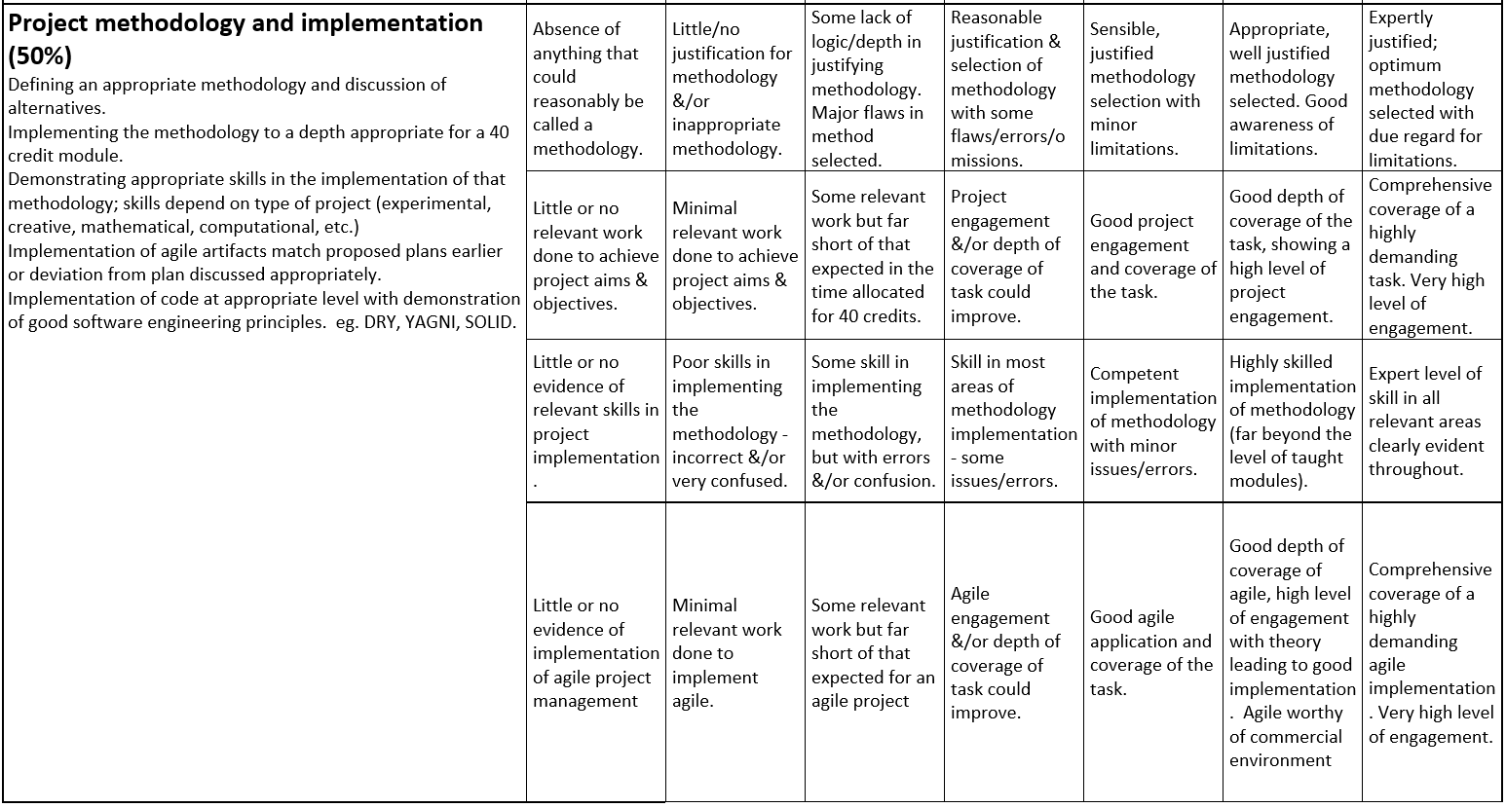
Method of approach – Done 2k Words
This counts towards the 5k for project methodologu and implementation maybe 2k words on this 5k on implementation

Slide 9
Implementation – 2.5k, 3k words

Slide 10
User Testing

Slide 11
Legal social ethical professional

Slide 12
Project Management

Slide 13
End Project Report

Slide 14
Reflections

Slide 15
Conclusions

Slide 16
References / Bibliography

